Slide 1
IN 3230 / IN 4230 Oracle Session – Week 2 – Raw Sockets
Praveensankar Manimaran
09/09/2021

Slide 2
Outline
Raw Socket Flow
Different Components needed
Packet socket
sockaddr_ll
Ifaddrs
iovec
ether_frame
msghdr

Slide 3
1 . Raw Socket Overview
Steps
Create Packet Socket (AF_PACKET)
Create physical layer address (sockaddr_ll)
Construct message header (msghdr)
Construct ethernet frame (ether_frame)
Point iovec to the ethernet frame (iovec)
Point iovec to the data
Add physical layer address

Slide 4
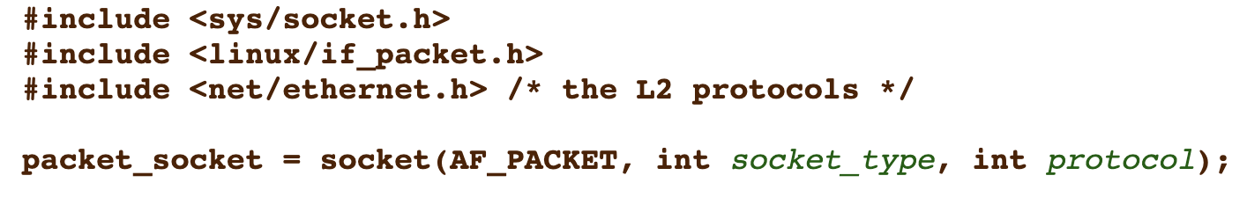
2 . 1 Packet Socket (AF_PACKET)
a
AF_PACKET:
Also called as "packet socket".
used to receive or send raw packets at the device driver
SOCK_RAW:
for raw packets
[1] https://man7.org/linux/man-pages/man7/packet.7.html

Slide 5
2 . 2 Sockaddr_ll
a
struct sockaddr_ll {
unsigned short sll_family; /* Always AF_PACKET */
unsigned short sll_protocol; /* Physical-layer protocol */
int sll_ifindex; /* Interface number */
unsigned short sll_hatype; /* ARP hardware type */
unsigned char sll_pkttype; /* Packet type */
unsigned char sll_halen; /* Length of address */
unsigned char sll_addr[8]; /* Physical-layer address */
};
[1] https://man7.org/linux/man-pages/man7/packet.7.html
[2] https://github.com/spotify/linux/blob/master/include/linux/if_ether.h

Slide 6
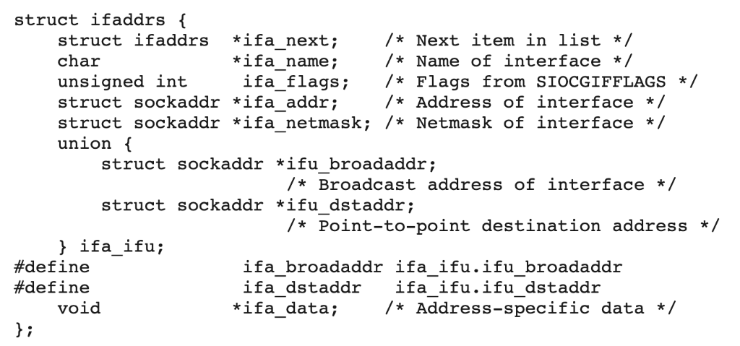
2 . 3 ifaddrs
a
creates a linked list of structures describing the network interfaces of the local system, and stores the address of the first item of the list in *ifap.
Important fields: ifa_next, ifa_name and ifa_addr
[2] https://man7.org/linux/man-pages/man3/getifaddrs.3.html

Slide 7
2 . 4 iovec
a
struct iovec { ptr_t iov_base; /* Starting address */ size_t iov_len; /* Length in bytes */ };
iov_base – stores the starting address
Iov_len – stores the length
Why it's needed ?
It's used by the message header (msghdr)
To point to ethernet frame header and the payload

Slide 8
2 . 5 ether_frame
a
struct ether_frame {
uint8_t dst_addr[6];
uint8_t src_addr[6];
uint8_t eth_proto[2];
uint8_t contents[0]; } __attribute__((packed));
It's frame header we use in the raw socket
__attribute__ ((packed)): it packs the ether_frame in such a way that it preserves memory (removes automatic padding between the structure members)

Slide 9
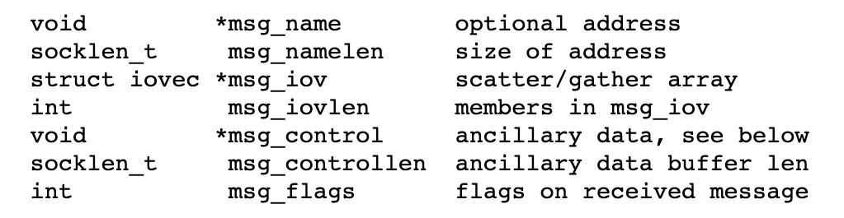
2 . 6 msghdr
a
Msg_name : sockaddr pointer will be used here (struct sockaddr_ll *)
Msg_namelen: size of sockaddr pointer
Msg_iov: array of io vector structures ( we use 2 arrays. One to point to the frame header and the 2nd one to point to the frame payload)
Msg_iovlen: no of numbers in msg_iov ( 2 in our example)

Slide 10
References
https://man7.org/linux/man-pages/man7/packet.7.html
https://man7.org/linux/man-pages/man3/getifaddrs.3.html
http://www.ccplusplus.com/2012/02/struct-iovec-iov.html
msghdr : https://pubs.opengroup.org/onlinepubs/7908799/xns/syssocket.h.html

Slide 11
Thank You

